Slide 1
Human Resources
Data analysis Specialist – DEPI
ALX1_DAT1_G2e
Group No.: (3)
Hend Mohammed Abd El-Ghafour
Marina Nabil Farag Morkoss
Esraa Ashraf Othman Eldesouky
Sarah Ayman Mohamed Eldeeb
Iman Abdelfattah Mohmed Elamroussi

Slide 2
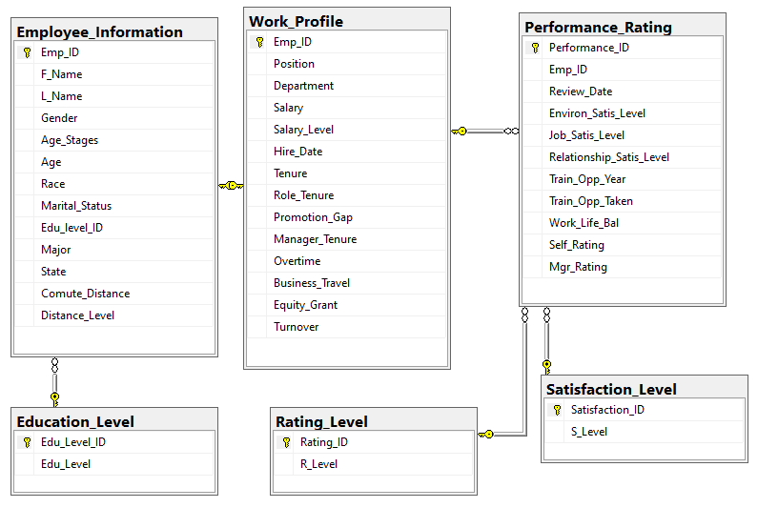
Introduction
Comprehensive insights into employee performance and satisfaction.
Five interrelated tables.
Serving a specific purpose in analyzing various aspects of employee experience and performance metrics.

Slide 3
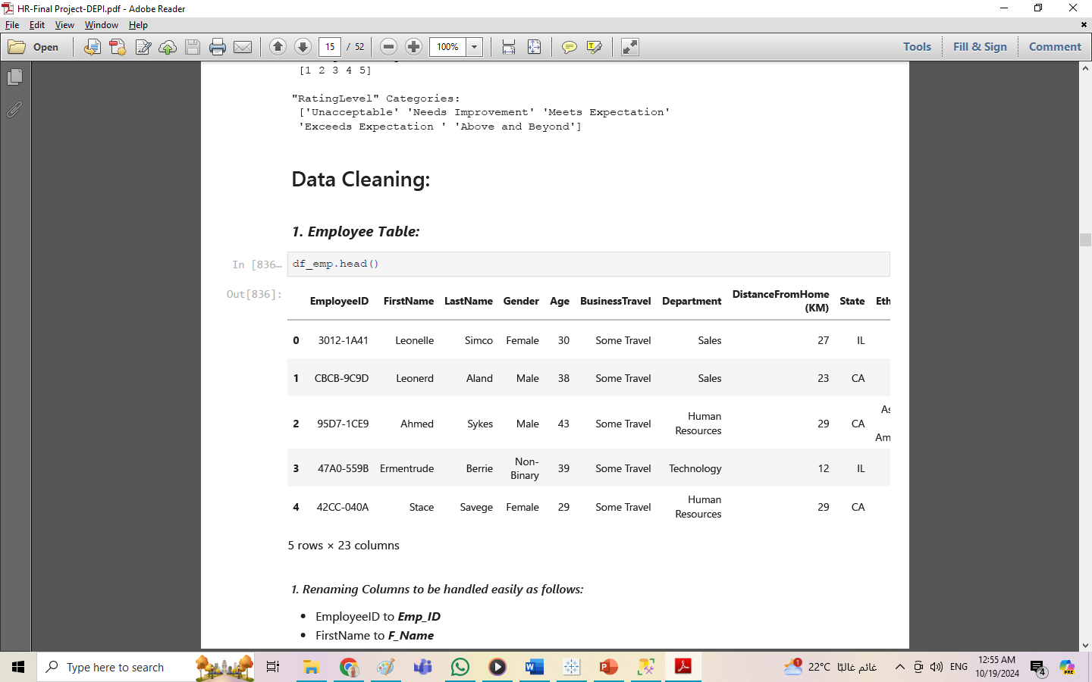
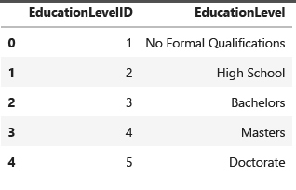
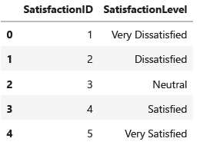
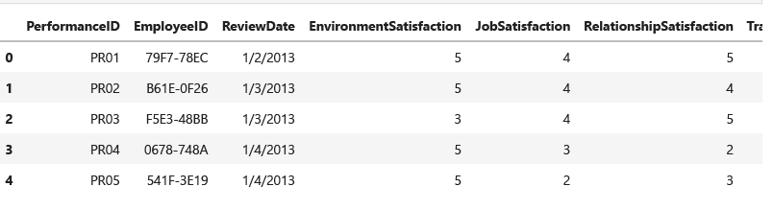
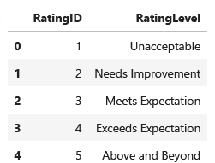
Dataset Description
Employee.csv
EducationLevel.csv
SatisfiedLevel.csv
RatingLevel.csv
PerformanceRating.csv

Slide 4
Data Cleaning & Preprocessing:
Using Python:
Renaming Columns
Changing dates data types
Arranging columns
Creating Age Distance & Salary Groups
Dividing tables the consists of large number of columns
Transferring tables to SQL:
Adjusting the data types of each table
Assigning Primary & Foreign Keys
Creating HR Diagram
Creating the necessary views
Adding necessary calculated columns

Slide 5
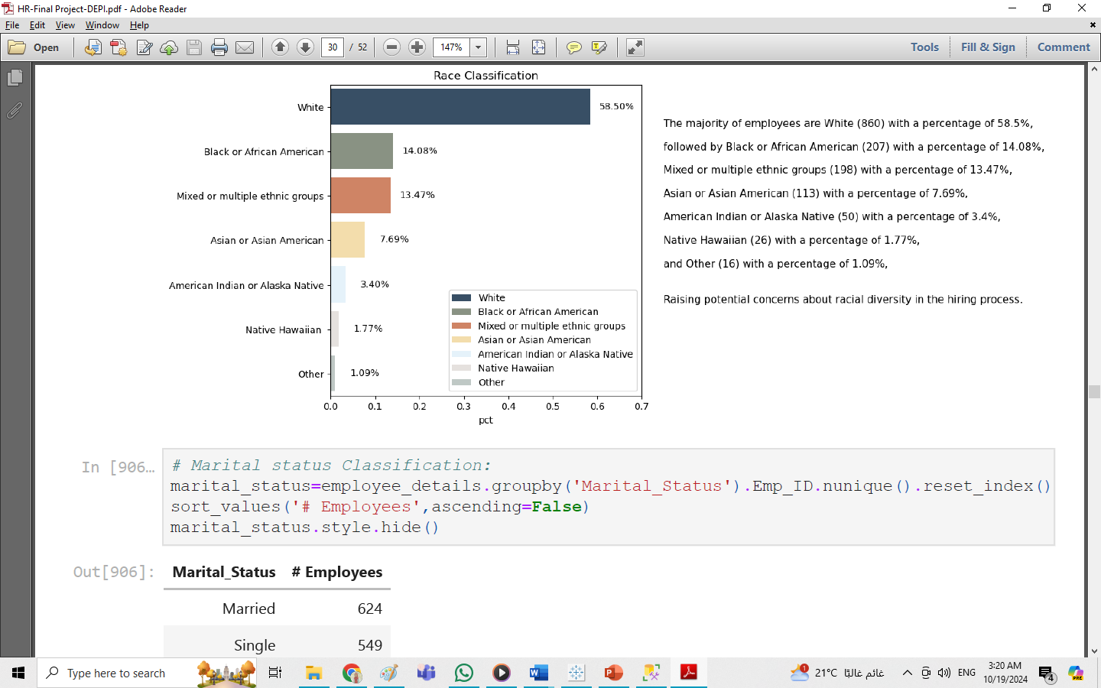
Initial Investigation
Objective:
Extract the suitable questions that are needed to be asked using Python
Main Findings :
The majority of employees are White (58.5%) - raise potential concerns about racial diversity in the hiring process
Major: Computer Science 29.93% and Information Systems 24.69% - Technology-related industry.
Distance levels : relatively normally distributed
Significant gap in salaries:
Large number of outliers, right-skewed when visualized - raising concerns about fairness in salary distribution.
Outliers are mostly distributed among managers and senior employees.
Highest hiring process was in 2022 (155) & 2012 (151) - The peak occurred at the start and the end of the investigated period.
The number of resigned employees is increasing across the years.
Further investigation revealed that all employees who had no performance ratings had been with the company for a year or less.
The gap between the opportunities offered by the company and the opportunities taken is increasing each year.

Slide 6



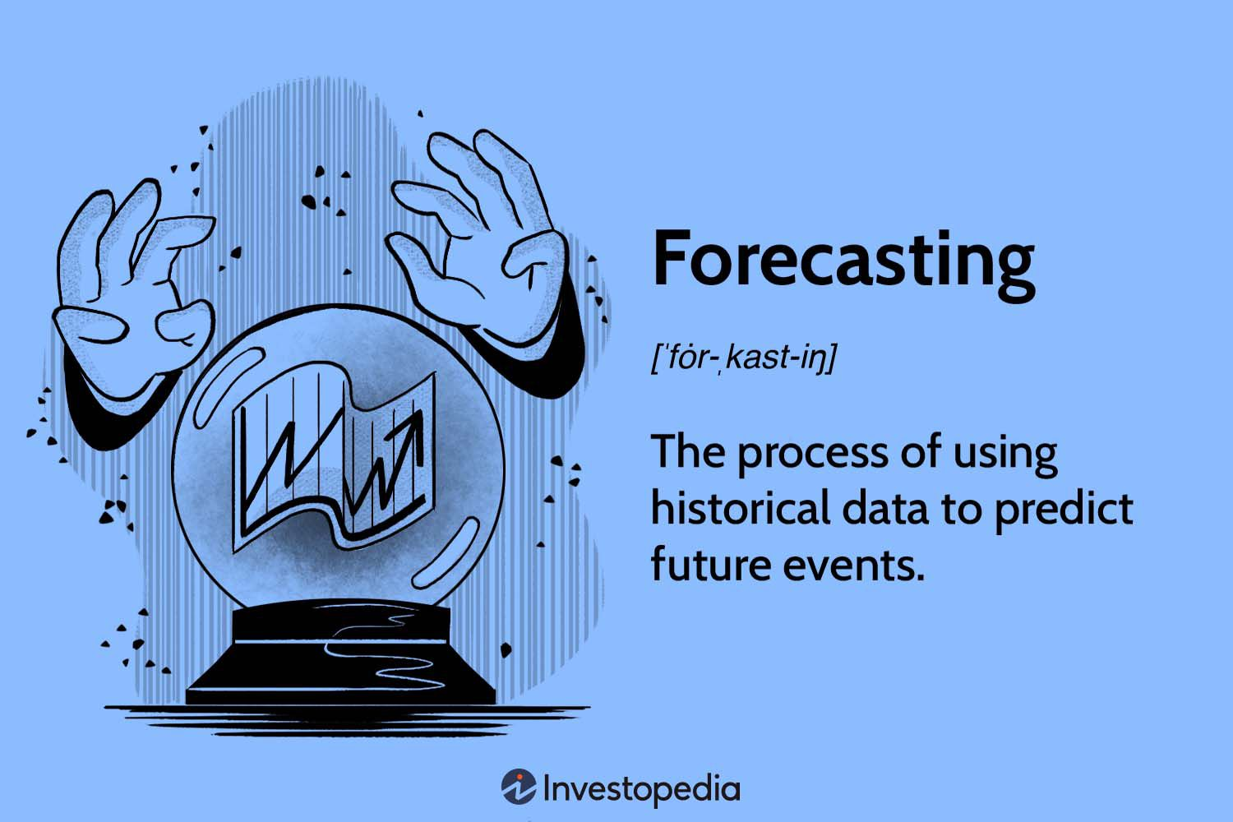



Questions:
Race Analysis
Demographics & Personal Information
Gender Analysis
Work Profile
Satisfaction & Performance
Opportunities & Growth

Slide 7
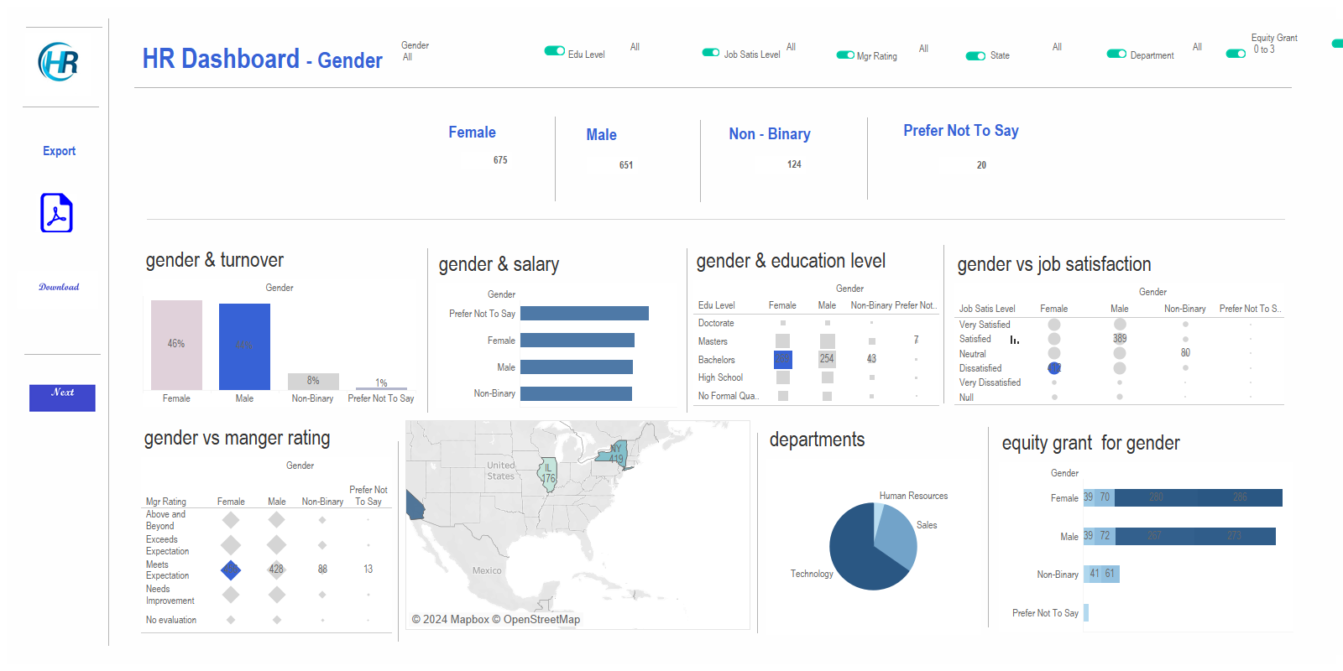
Gender Analysis
Conclusion:
Males represent the highest turnover because of salary bias. Many males with doctorate and master's degrees receive lower average salaries compared to other genders.
Manager rating shows no bias , as the highest rating for all genders Similarly "meets expectations.”
No bias in equity grant for all employees even if length of work one year or less and regardless of education level ,that means equity grant not depends on manager rating or education level.

Slide 8
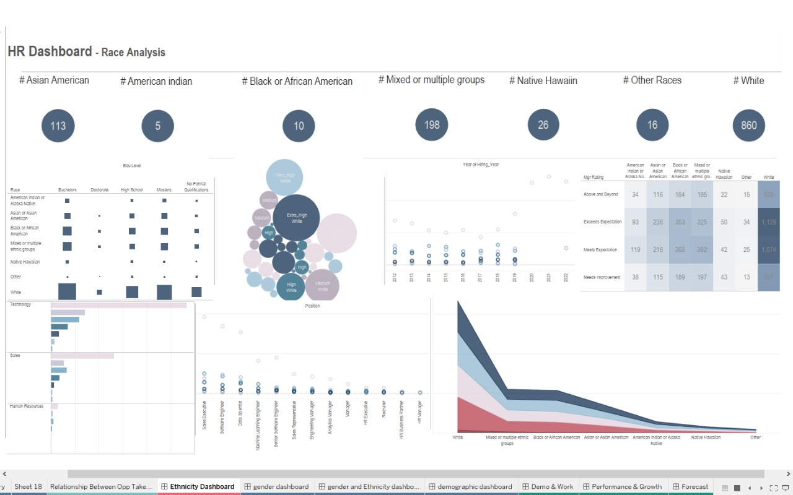
Race Analysis
Conclusion:
Based on calculations of the existing workforce, it is clear that the organization is diverse.
White employees make up a large portion of the workforce, as evidenced by the annual hiring total. Additionally, the only people hired in 2020 and 2021 were white.
Since there were a lot of white employees in every department, this large number of employees has been seen in many areas.
Because of the significant disparity in the rates for the other races, white employees have received the highest and lowest salaries, respectively.
When it comes to managerial ratings, white employees rank higher than any other race in both positive and unfavorable ratings. The reason for that is the exceeding count of the white employees above the other races.

Slide 9
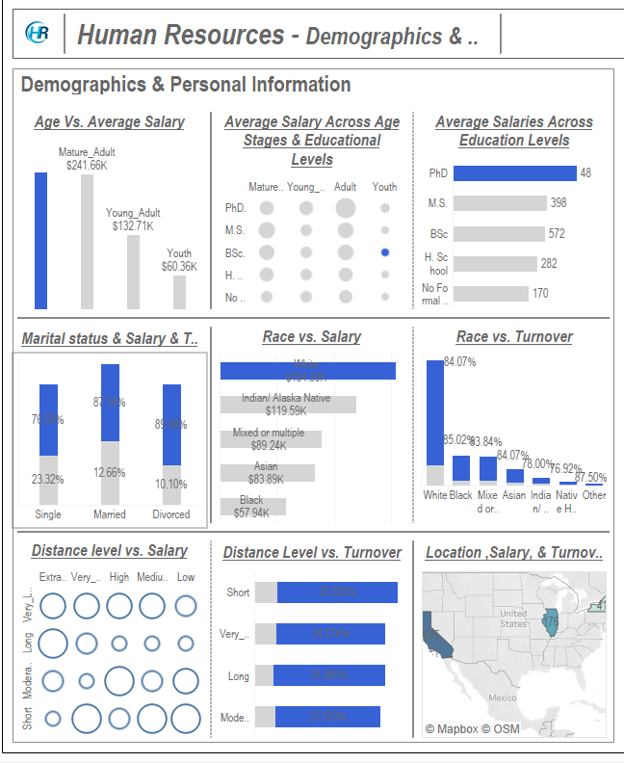
Demographics
Conclusion:
Salary depends on education level more than depending on age.
There is salary bias for white employees and regardless of their high salary they represent the highest count of employees turned over.
The highest count of employees turned over are single.
The highest employees turned over have “bachelors”.
The distance level has no impact on turnover because employees turned over their distance level “short” that means the salary may depends on distance level and compensation transport.

Slide 10
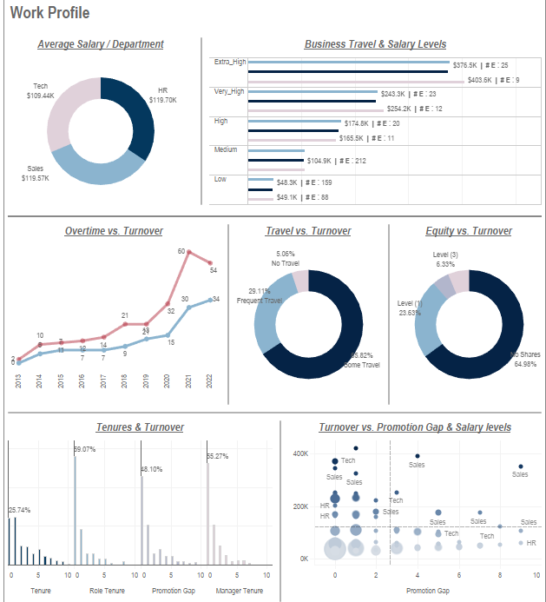
Work Profile:
Conclusion:
Salary is influenced by position and age, with Frequent Travelers earning the highest overall (except in the medium level with occasional travel).
Further investigation is needed on the impact of overtime on salary levels.
The relationship between salary and equity shares varies across departments, showing inconsistency.
Most resigned employees were frequent or occasional travelers, possibly linked to the lack of equity grants.
Early tenure resignations are common, especially within the first 1-2 years.
Salary plays a significant role in reducing turnover, but the effect of promotion gaps on turnover needs further study.
The increase in resignations among shorter-tenure employees suggests complex hiring motivations beyond simply replacing outgoing staff.

Slide 11
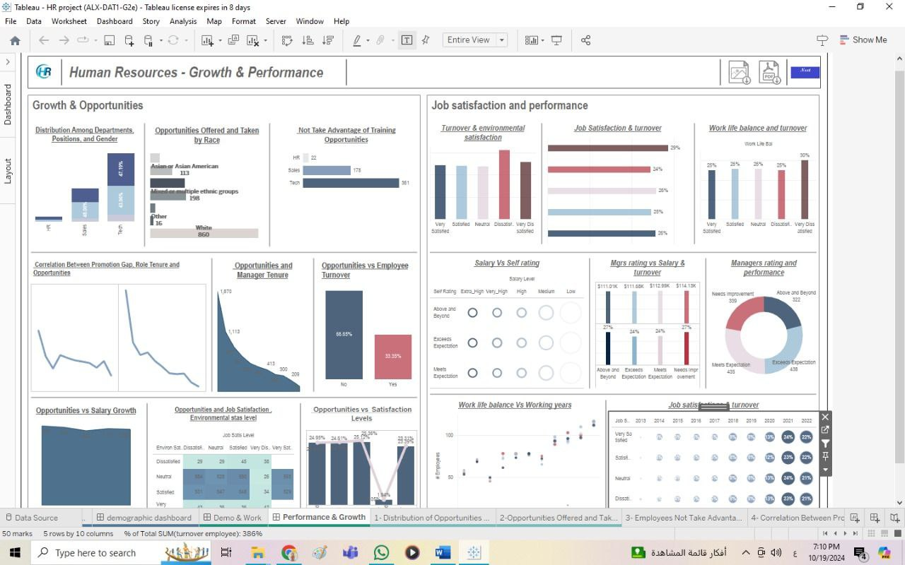
Growth & Opportunities
1- Unequal Opportunity Distribution:
Race & Gender: White employees receive the majority of opportunities (860). Training opportunities are underutilized, especially in Tech (361).
2- Promotion & Manager Tenure:
Promotion Decline: Fewer promotions as tenure increases.
Manager Tenure: Long-tenured managers offer fewer opportunities.
3 - Opportunities Reduce Turnover:
66.65% of employees with opportunities stay, while 33.35% leave.
4- Opportunities Drive Salary Growth & Satisfaction:
Employees receiving opportunities see higher salary growth, especially mid-career.
Satisfaction and growth are strongly linked.

Slide 12
Satisfaction & Performance
From the dataset analysis the following were concluded:
Work environment dissatisfaction and poor work-life balance are key factors linked to employee turnover, suggesting these areas require improvement.
Relationship satisfaction and performance ratings (both self and manager) seem to have minimal impact on salary and turnover.
Frequent performance assessments may not be a strong predictor of promotion, as many promoted employees were only assessed once.
Job satisfaction alone does not appear to drive turnover, as even highly satisfied employees experienced increased turnover rates in recent years.

Slide 13
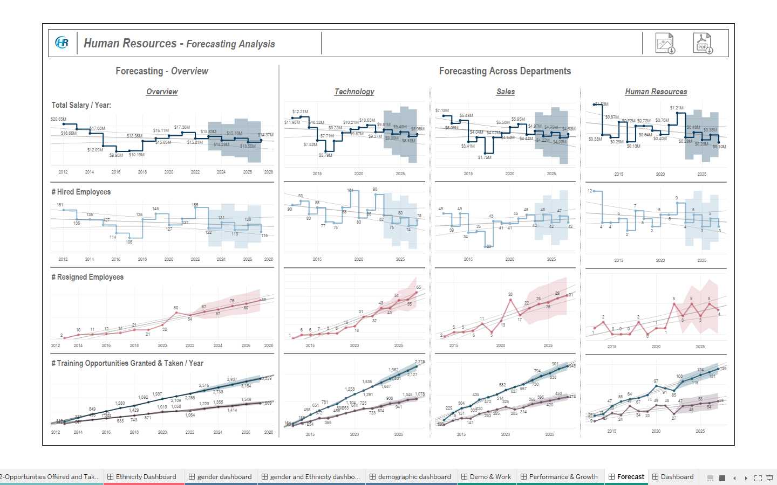
Predictive Analysis – Overall & Across Departments
Salary Forecast (2023-2027)
Hired Employees (2023-2027)
Resigned Employees (2023-2027)
Opportunities Offered & Taken (2023 – 2027)

Slide 14
Future Researches
Does longer tenure or role tenure lead to higher salaries?
What caused the maximum hiring in 2012 & 2022, and how does it relate to turnover?
What is the technique used in distributing equity grant in each job role across departments?
How travel duties influence employee turnover more comprehensively.
Forecasting:
Improving the salaries model.
Deeper analysis into non-seasonal factors affecting hiring trends.
Factors that impact resignation trends.
Explore other factors affecting training opportunities across departments.

Slide 15
Thank You ☺

